Slide 1
Register/Log-in Utility Access Payment Portal
Welcome to the Online Payment Portal for the City of Plant City. This portal provides you the ability to pay your utility bill from the convenience of your home/office/phone.
There are two options for payment:
Pay as a Guest (one time payment)
Register your account ( beneficial for Auto draft, viewing utility bill, and updating customer information)
Please use the following instructions to pay your invoices. If you need further assistance, please contact the Utility Billing Department at (813) 659-4222 or email us at customerservice@plantcitygov.com

Slide 2
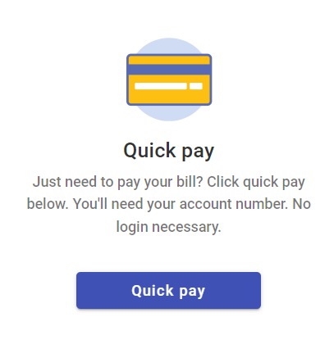
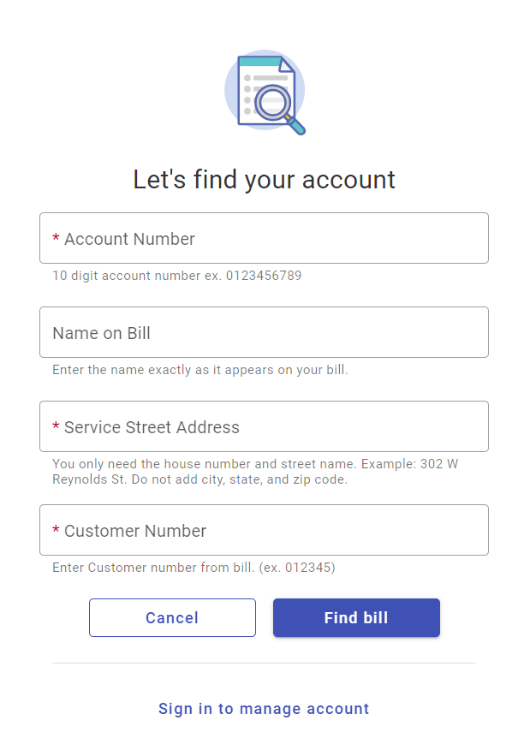
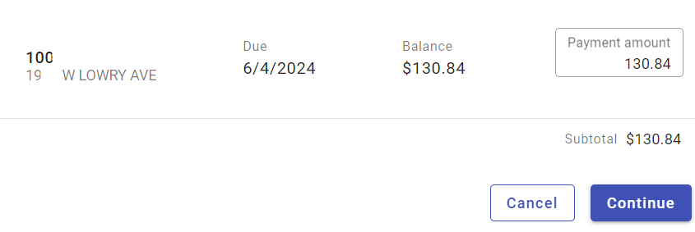
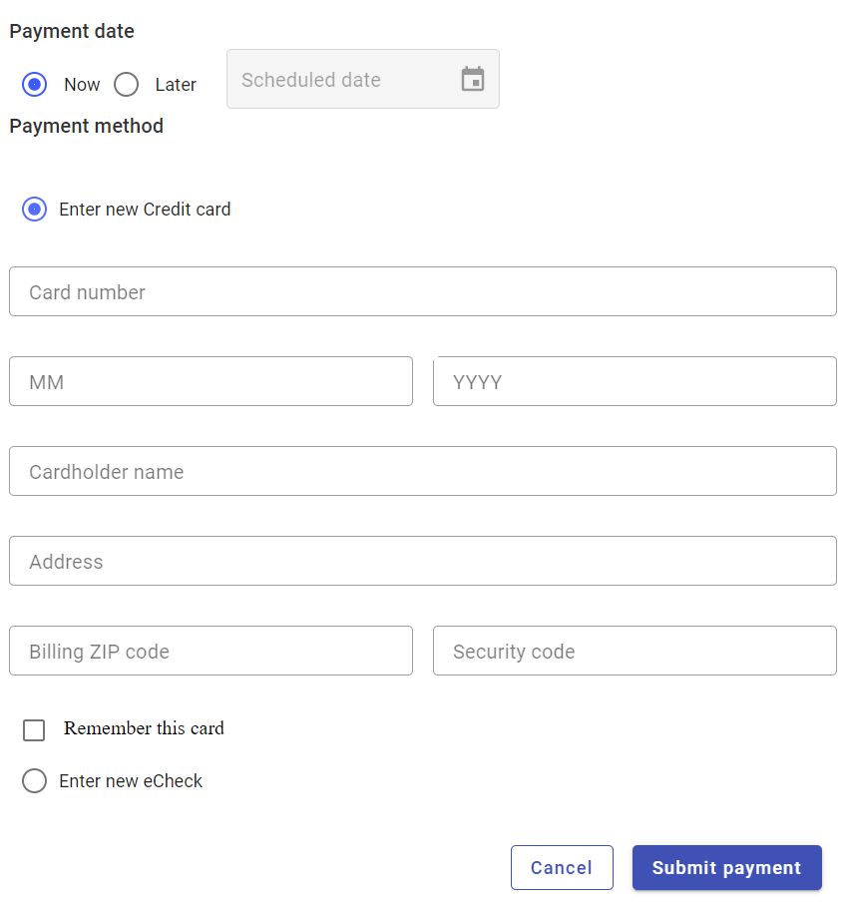
Pay as a Guest- One time payment https://cityofplantcityfl.municipalonlinepayments.com/cityofplantcityfl/utilities
Step 2. Enter your account information as listed on your bill
Step 1. Click Quick Pay to make a one-time payment as a guest
Step 4. Enter your preferred payment method and submit payment
Step 3. Your bill information will appear showing the total amount due

Slide 3
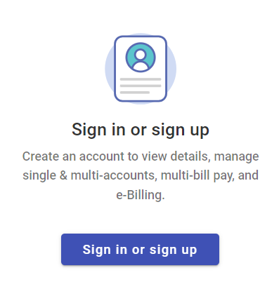
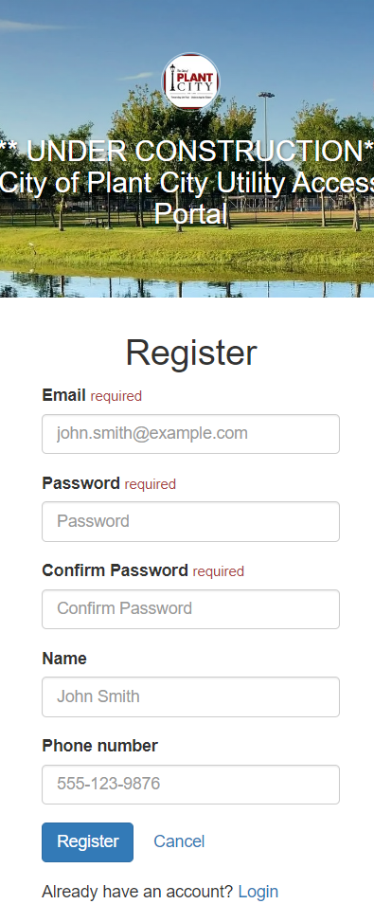
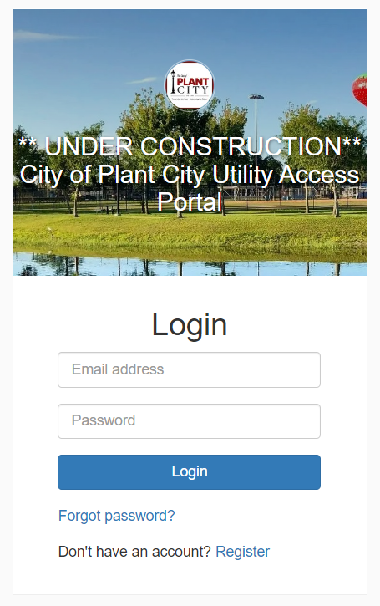
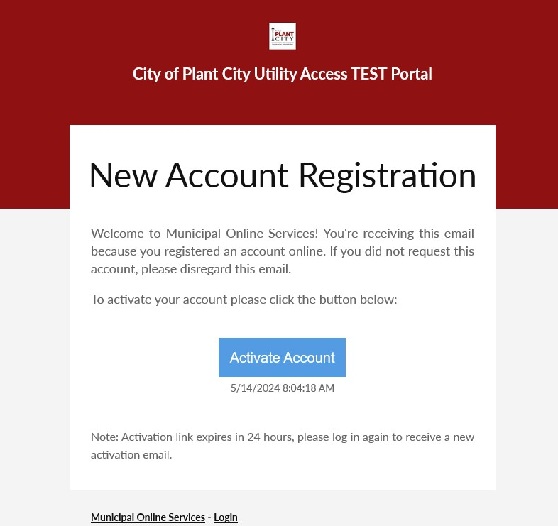
Creating a New Account Utility Billing https://cityofplantcityfl.municipalonlinepayments.com/cityofplantcityfl/utilities
Step 3. Enter your email address and a password
Step 1. Select the sign in or sign-up button
Step 2. Click the register button
Step 4. You will receive a new account registration email. Click on the link to activate your account and log in

Slide 4
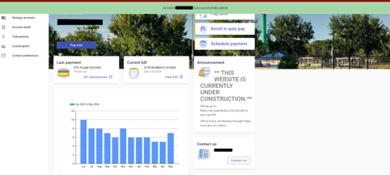
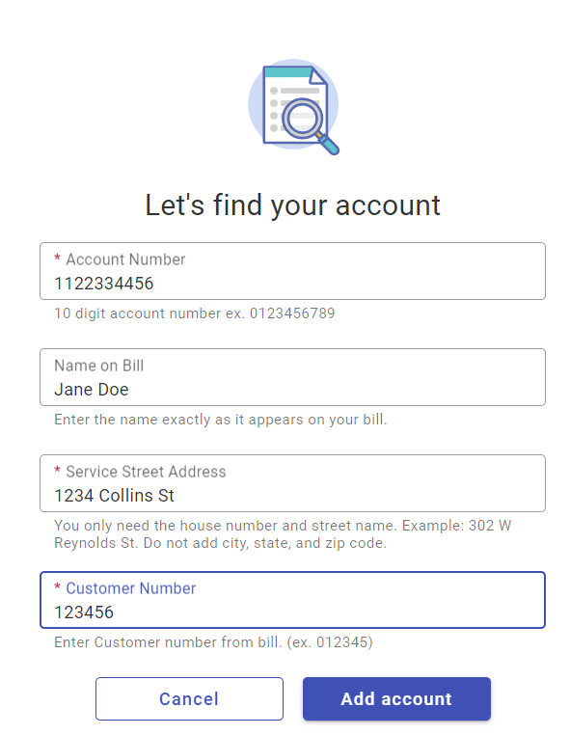
Creating a New Account Utility Billing (continued)
Step 5. Add an account
Step 6. Enter account information as shown on your utility bill
Step 7. You will get confirmation the account was successfully added to your online access

